Slide 1
DDU FORUM
Developed By:-
Umang Borad(IT-15)
Shubham Bhatt(IT-11)
Hardik Adesara(IT 01)

Slide 2
Under the Guidance of
Prof. V.K. Dabhi
Department of Information Technology,
Faculty of Technology,
Dharmsinh Desai University, Nadiad
Gujarat.

Slide 3
INTRODUCTION
DDU Forum Application is an Android Application intended to ease the communication between students without using internet
Real-time experiences between multiple devices
Wi-Fi Group chatting makes use of Samsung Chord Technology

Slide 4
INTRODUCTION(Cont.)
You can create Wi-Fi hotspot in your device and have others connected to it
One server monitors all other clients connected to it

Slide 5
Purpose
The application features include:
Easy discovery and connection with nearby devices
Real time experiences between multiple users
No need of internet access

Slide 6

Logo of DDU FORUM

Slide 7
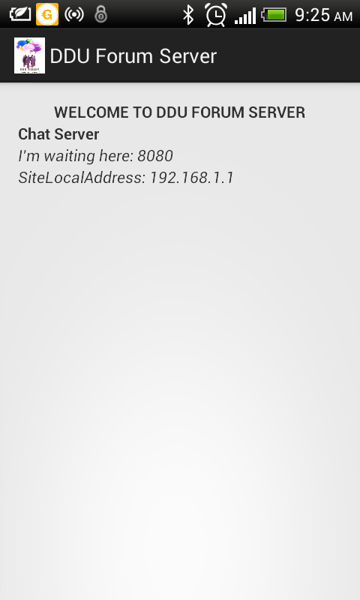
Server is ready to handle & monitor clients.

Slide 8
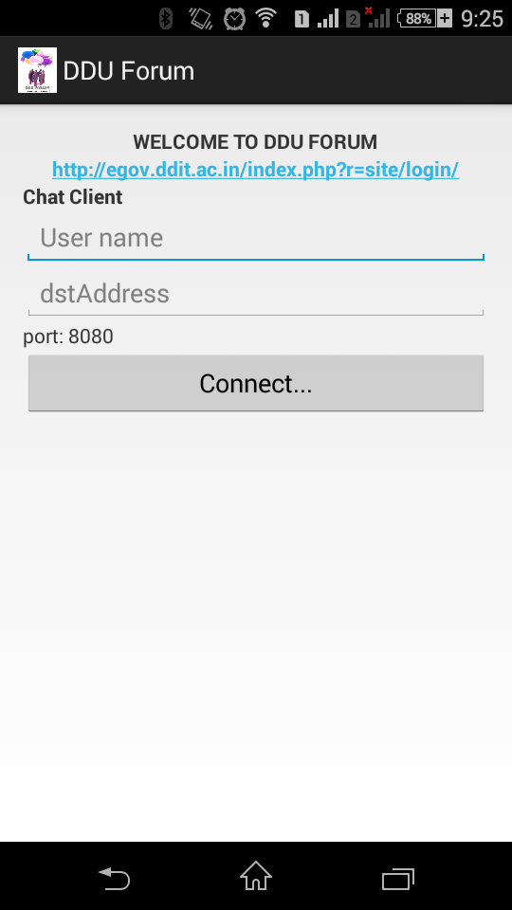
Client is ready to connect with server

Slide 9
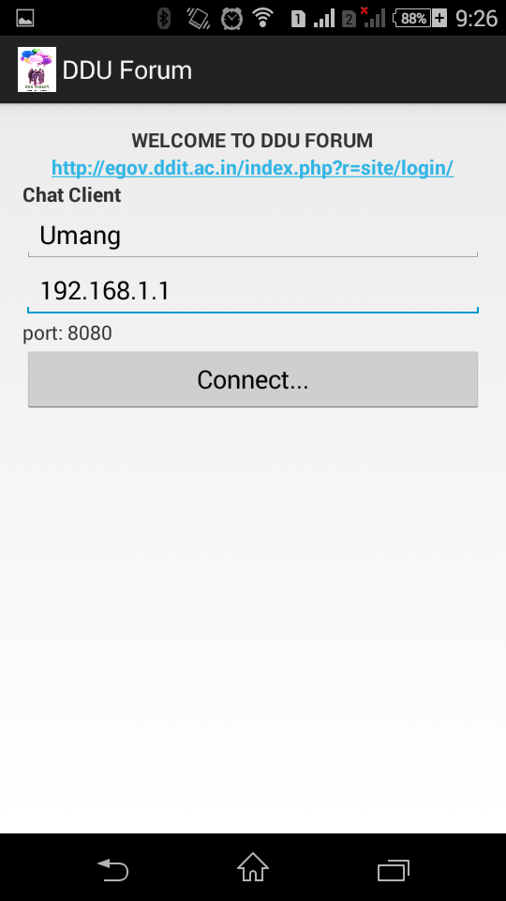
Client request to server for connection

Slide 10
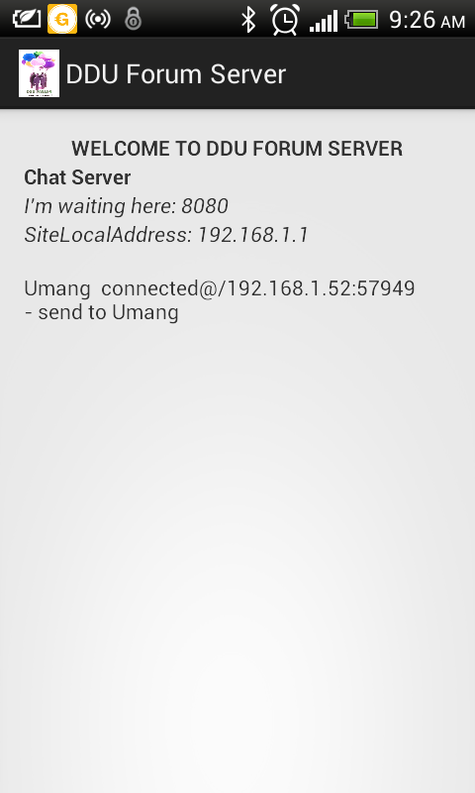
Server accept the connection and client is ready for chatting

Slide 11
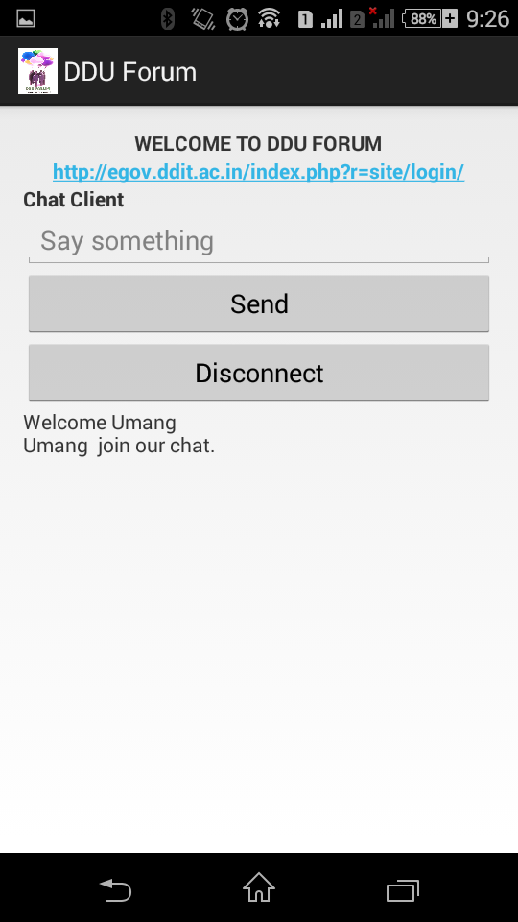
Client can send the message and disconnect the connection and also can go to student panel site of ddu

Slide 12
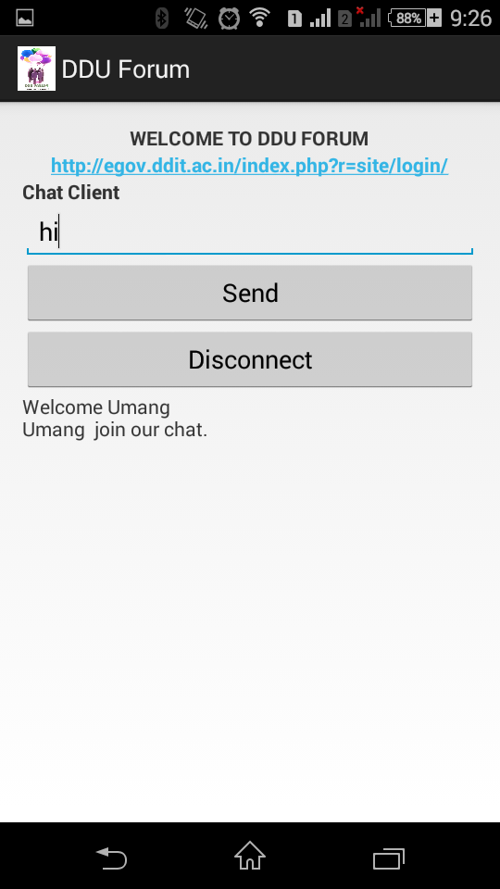
Client write the message and send it to another clients via server

Slide 13
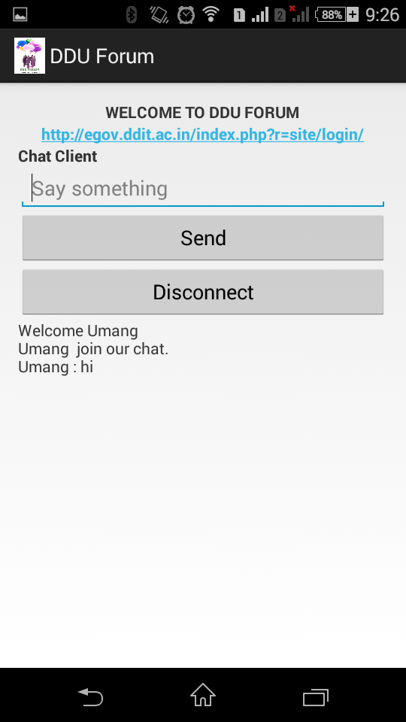
client sent message to another clients and it received

Slide 14
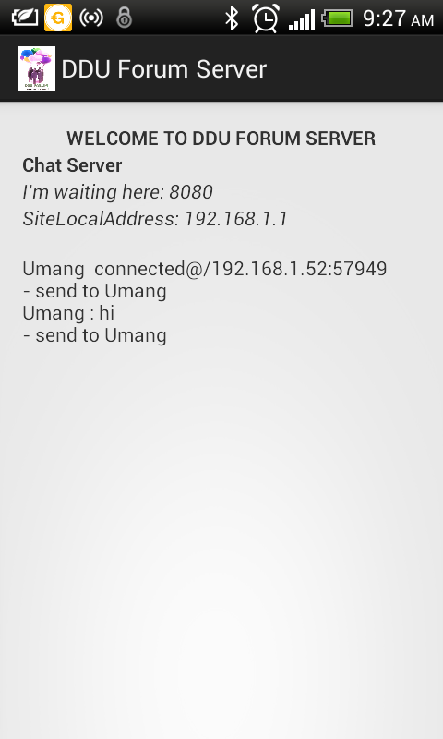
server can monitor all messages and make log of it

Slide 15
FUTURE ENHANCEMENT
A feature for personal chat is also welcomed but with safety constraints of its own
File sharing must be included in future.
We give more security to messages.

Slide 16
FUTURE ENHANCEMENT
Authentication of clients can make more secure
Every client can set profile pic
Clients feedback is very important for us so we do changes on base of that in future

Slide 17
Summary
DDU Forum contains all the required basic functionalities for Wi-Fi chatting application
It can be enhanced in future

Slide 18
Bibliography
www.youtube.com
www.stackoverflow.com
www.mybringback.com

Slide 19
!!! THANK YOU !!!

